Slide 1




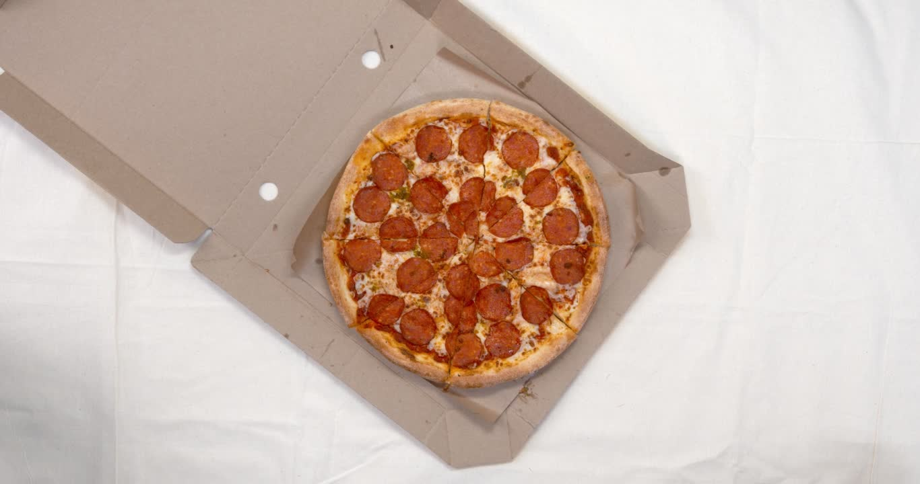







THE PIZZA SHOP
A datascience Project

Slide 2
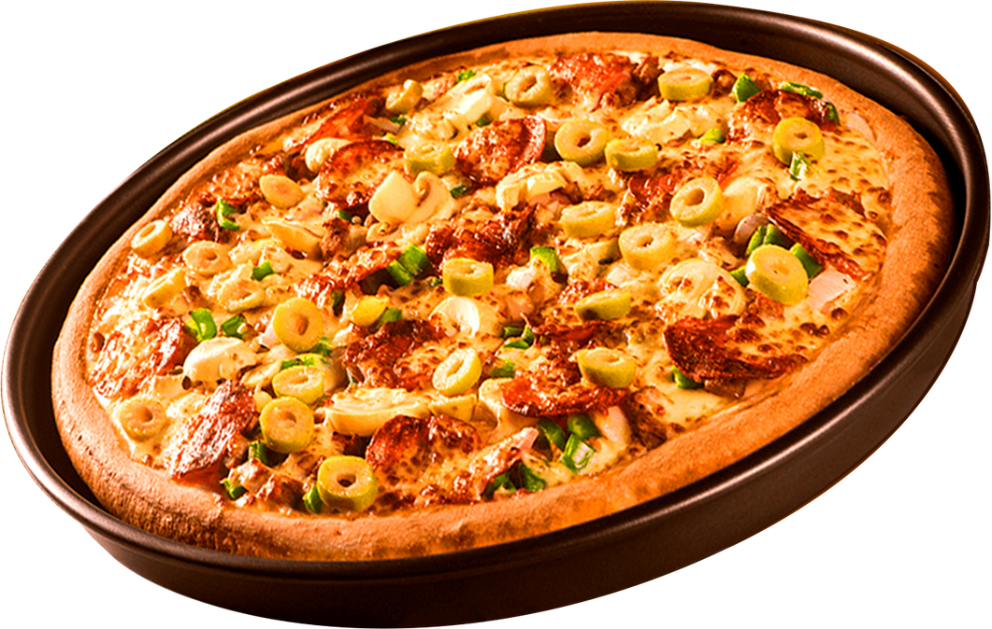
INtroduction
This project aims to address various business needs of a pizza shop by leveraging SQL (Structured Query Language). By using SQL, the project provides insights into sales, inventory management, customer preferences, and operational efficiency, helping the pizza shop make data-driven decisions to improve its performance and customer satisfaction.

Slide 3



About me
My name is Viresh Gupta, and I am an enthusiastic data analyst with a strong background in SQL and data-driven decision-making. I have a passion for leveraging data to uncover insights and improve business operations. Through this project, I aim to demonstrate how SQL can be utilized to address the diverse business needs of a pizza shop, providing actionable insights that drive efficiency, customer satisfaction, and overall performance.

Slide 4

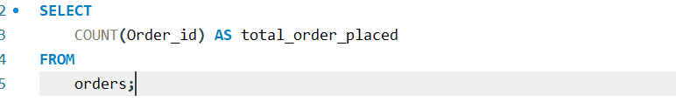
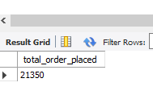
Retrieve total no of order placed

Slide 5

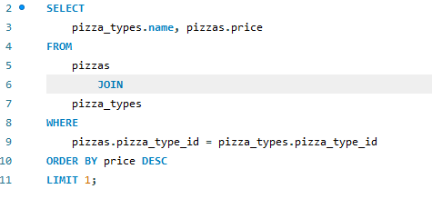
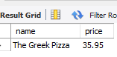
highesT - Priced Pizza

Slide 6
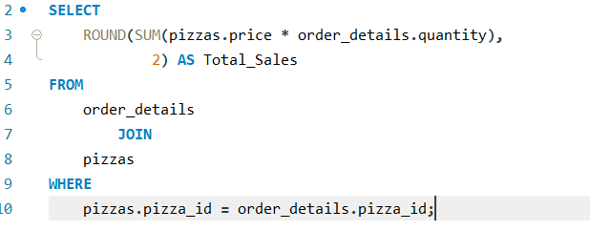
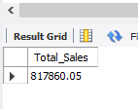
Calculate the total revenue generated from pizza sales.

Slide 7
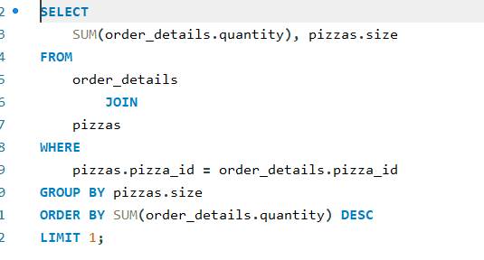
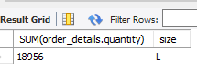
the most common pizza size ordered.

Slide 8
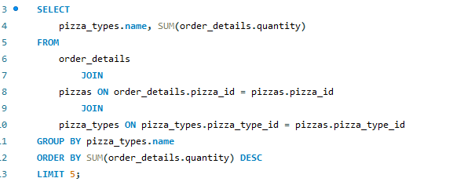
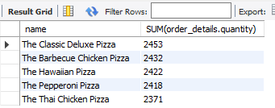
top 5 most ordered pizza types

Slide 9
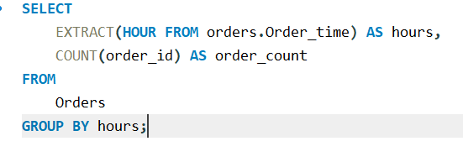
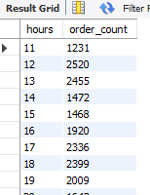



distribution of orders by hour

Slide 10
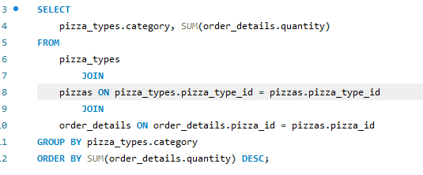
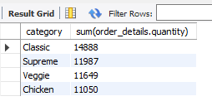
total quantity of each pizza category ordered

Slide 11
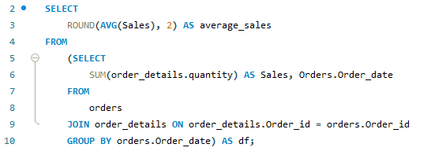
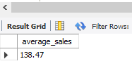
average number of pizzas ordered per day

Slide 12

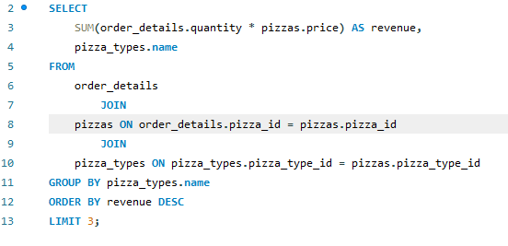
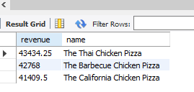
3 most ordered pizza B.o. revenue

Slide 13

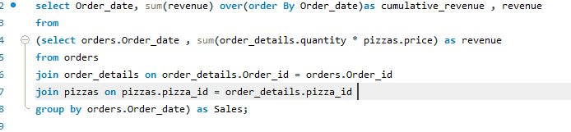
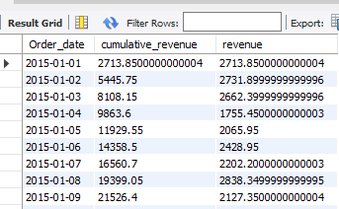
cumulative revenue generated over time

Slide 14
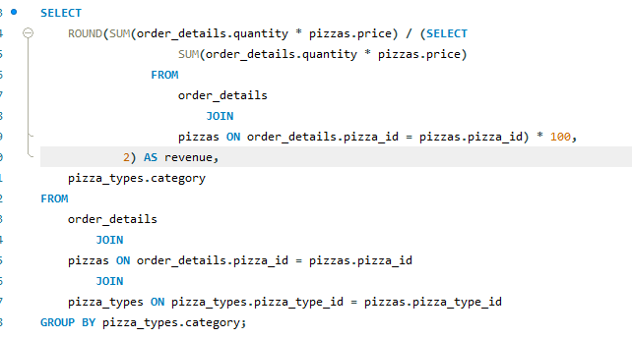
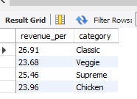
percentage contribution

Slide 15
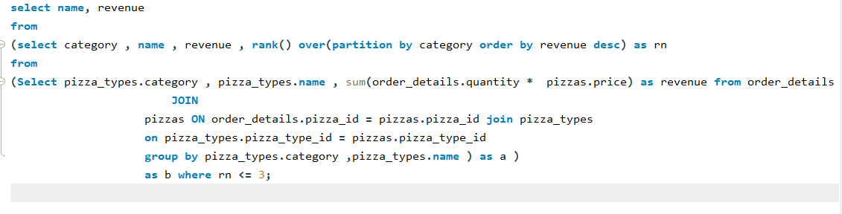
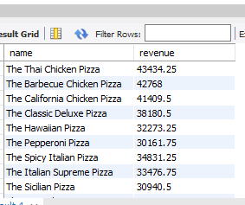
3 most ordered pizza Types B.o revenue & category

Slide 16
THANK YOU VERY MUCH

